Slide 1
MGM COLLEGE OF ENGINEERING
AND TECHNOLOGY
Topic :
Online voting
system
Presented by: Guide:
Bibin P. Varghese Asst. Prof. Chinnu C. George
Nibimol Abraham
Reshma Sabu
DEPARTMENT OF COMPUTER SCIENE
DESIGN PROJECT

Slide 2
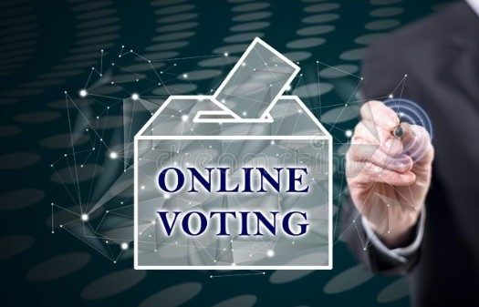
CONTENTS
Introduction
Existing System
Disadvantages
Proposed System
Advantages
Modules
UML Diagrams
Conclusion
References
2

Slide 3
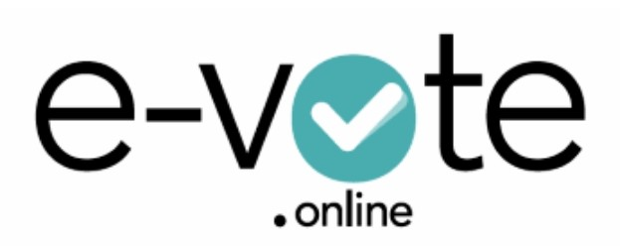
INTRODUCTION
Simple, safe and secure method that take minimum of time.
Secure website maintained by the Election Commissioner.
Revoting will be prohibited with proper authentication.
Counting will be done online.
Each voter need to have their own voters id.
3

Slide 4
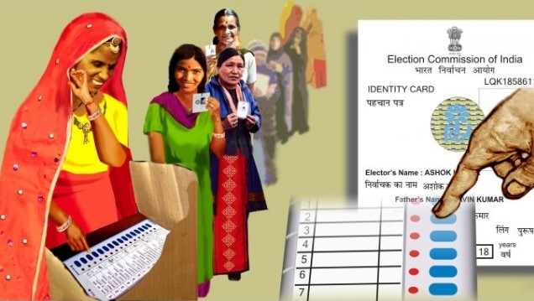
EXISTING SYSTEM
Need travel to the voting centre/booths.
Does not provide people the way to get the details about the
nominees.
Do not provide any provision to know the history of the
Candidate.
All information are filled manually.
Voter must be present in his/her Constituency.
4

Slide 5
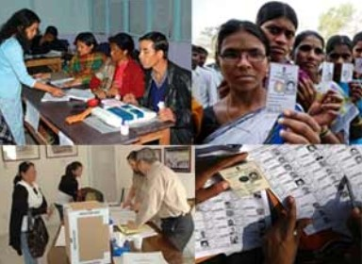
EXISTING SYSTEM
Disadvantages :
* Expensive and time consuming.
* Too much paper work.
* Errors during data entry.
* Loss of registration forms.
* Includes manual works.
5

Slide 6

PROPOSED SYSTEM
Planned approach towards working.
Accuracy.
Reliability.
No Redundancy.
Immediate storage of information.
Easy to Operate.
6

Slide 7
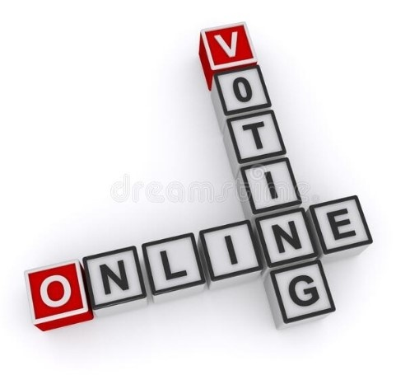
PROPOSED SYSTEM
Advantages :
* Time saving.
* Working load reduced.
* Information available at time.
* It provide security for the data.
7

Slide 8

MODULES
Admin
Candidate
Voter
8

Slide 9

MODULE DESCRIPTIONS
Admin:-
Verification of registration form.
Setting election date and time.
Conduct online polling.
Publishing Result.
Candidate :-
Registration.
Suggest an edit to their profile.
Cast vote.
View result.
9

Slide 10
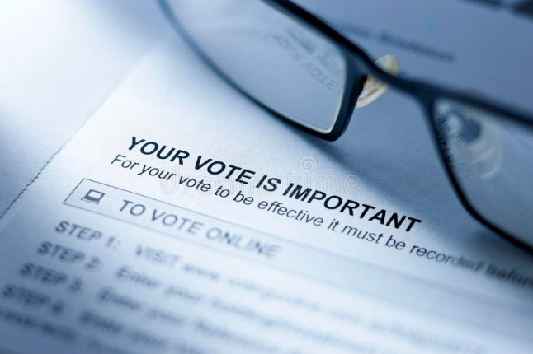
MODULE DESCRIPTIONS
Voter :-
Registration.
View Candidate list and details.
Cast vote.
View result.
10

Slide 11
UML DIAGRAMS
Class Diagram
Object Diagram
Use case Diagram
Activity Diagram
Sequence Diagram
11

Slide 12
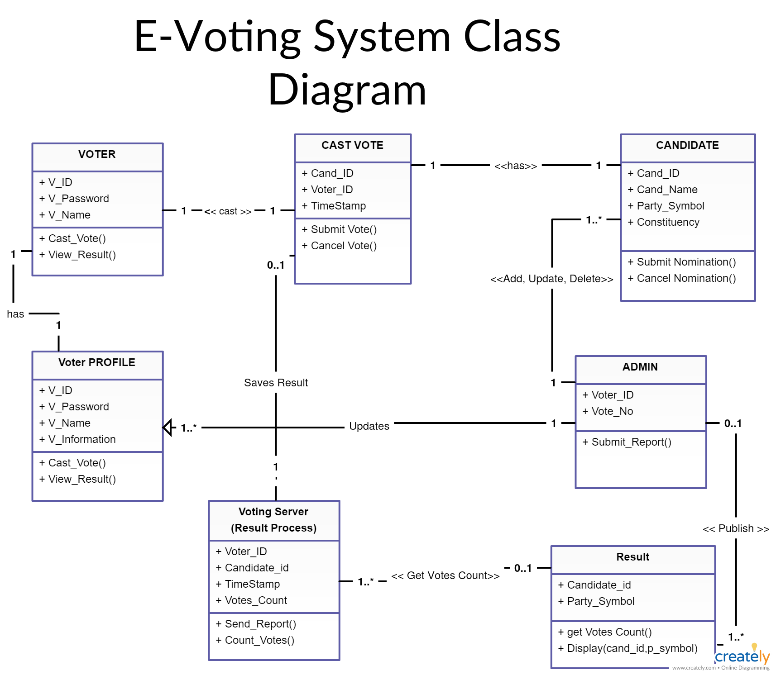
CLASS DIAGRAM
12

Slide 13
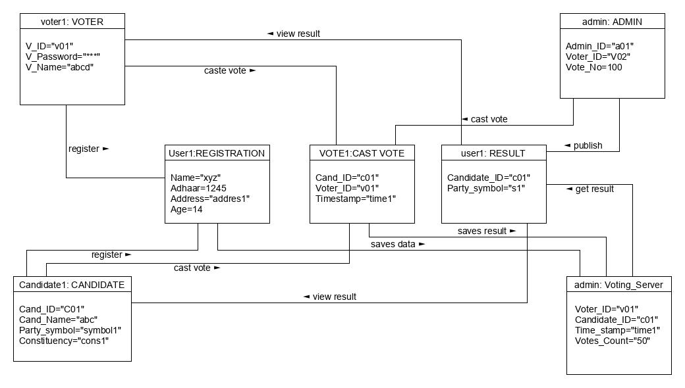
OBJECT DIAGRAM
13

Slide 14
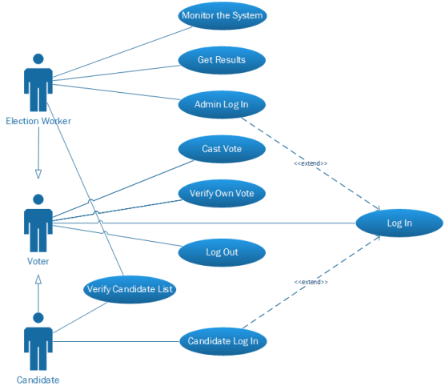
USE CASE DIAGRAM
14

Slide 15
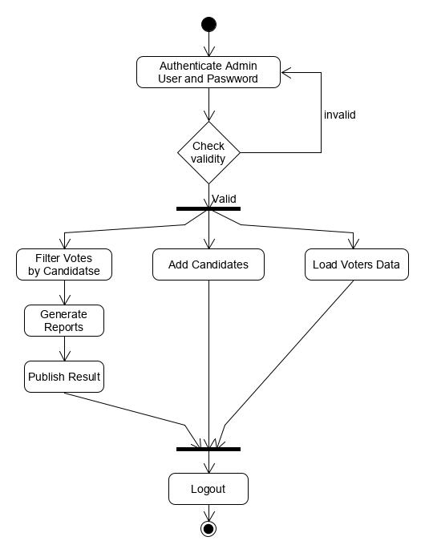
ACTIVITY DIAGRAM
Admin:-
15

Slide 16
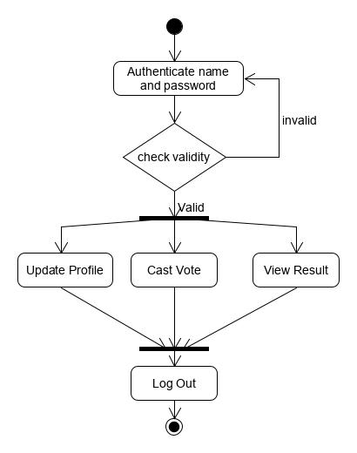
ACTIVITY DIAGRAM
Candidate :-
16

Slide 17
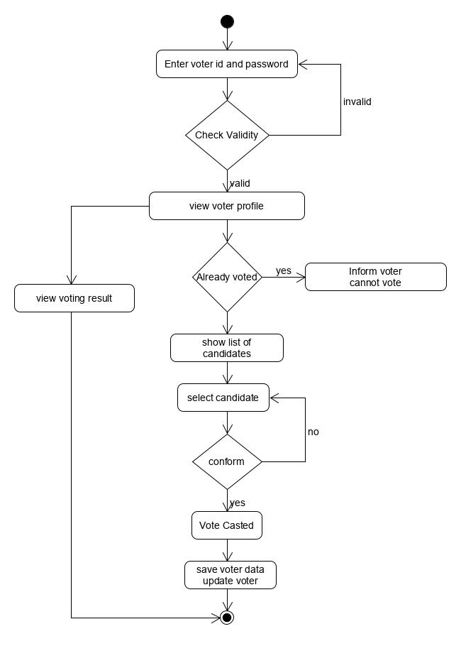
ACTIVITY DIAGRAM
Voter :-
17

Slide 18
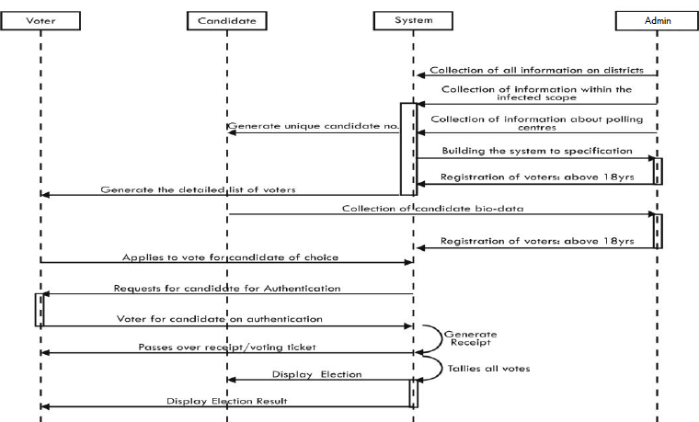
SEQUENCE DIAGRAM
18

Slide 19

CONCLUSION
Conduct free and fair elections.
Efficient and robust system.
Less effort and less labour intensive.
Increases the percentage of voting.
19

Slide 20
REFERENCES
www.google.com
www.wikipedia.com
www.studymafia.org
www.slideshare.net
20

Slide 21
THANK YOU
21

